Slide 1


Sprint 1 Retrospective
Cloud Group 5

Slide 2



Sprint 1 Overview
Period from Week 6 to Week 7
Project Setup
Trello • Google Documents • GitHub • MS Teams
Sprint Planning
Ownership Roles • User Stories • Story Points
Group Reflection

Slide 3
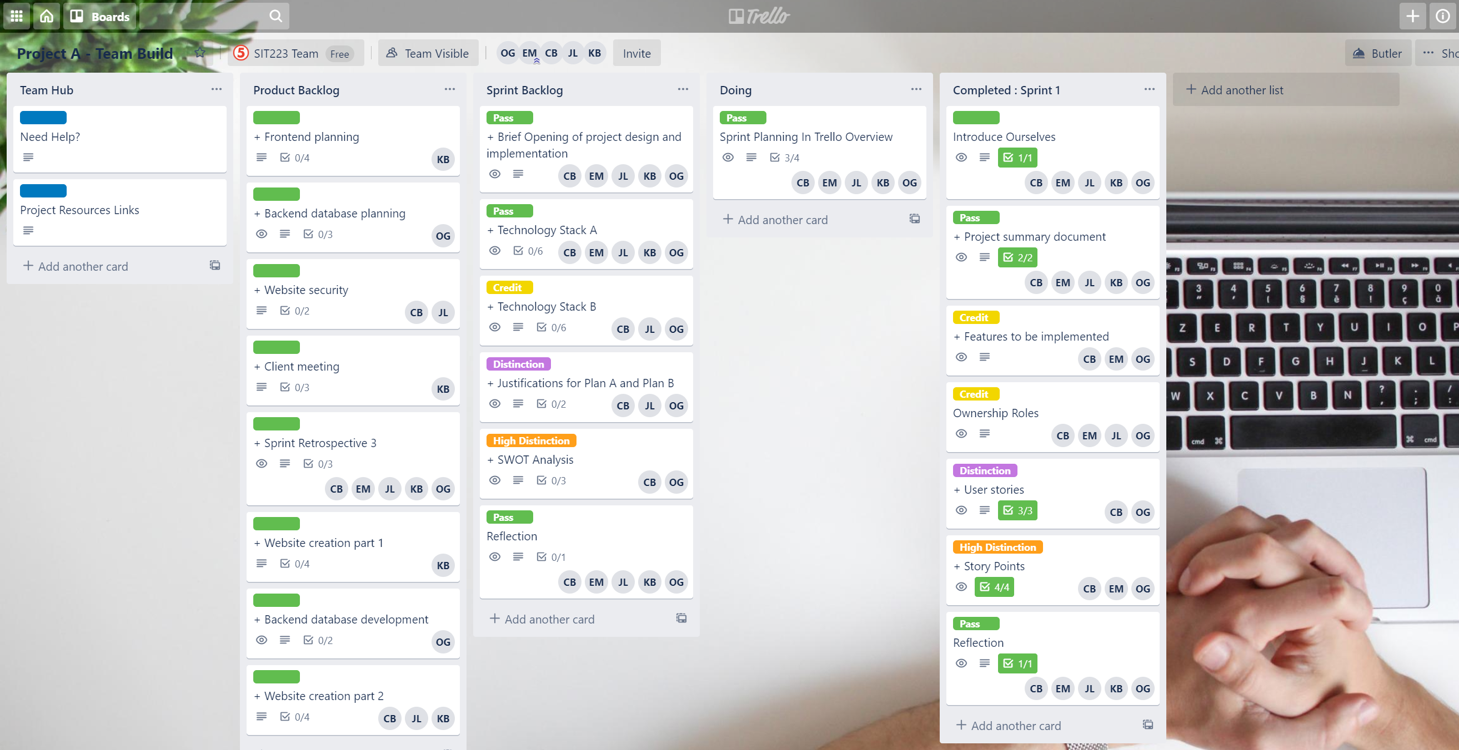
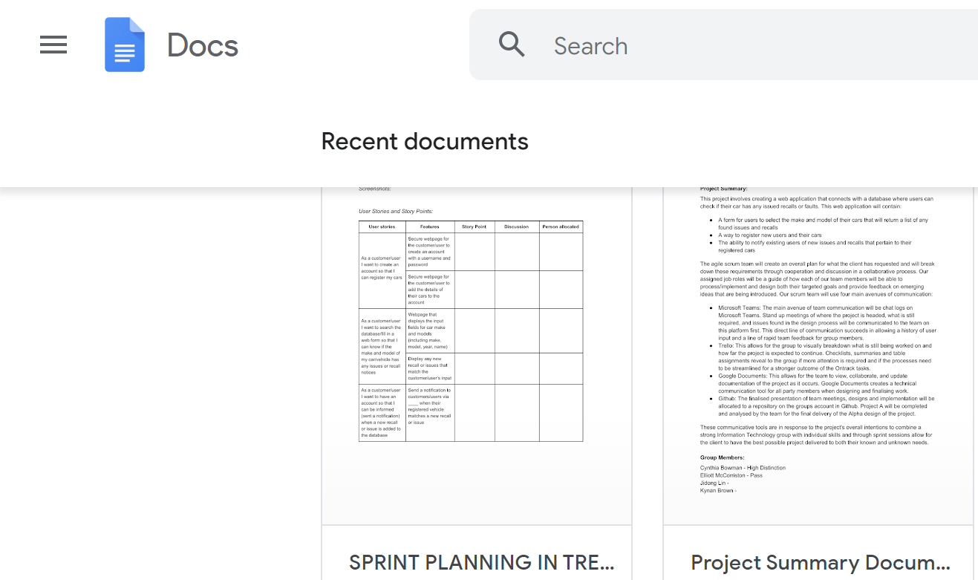
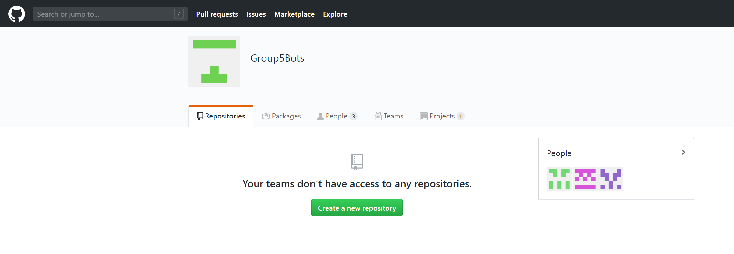
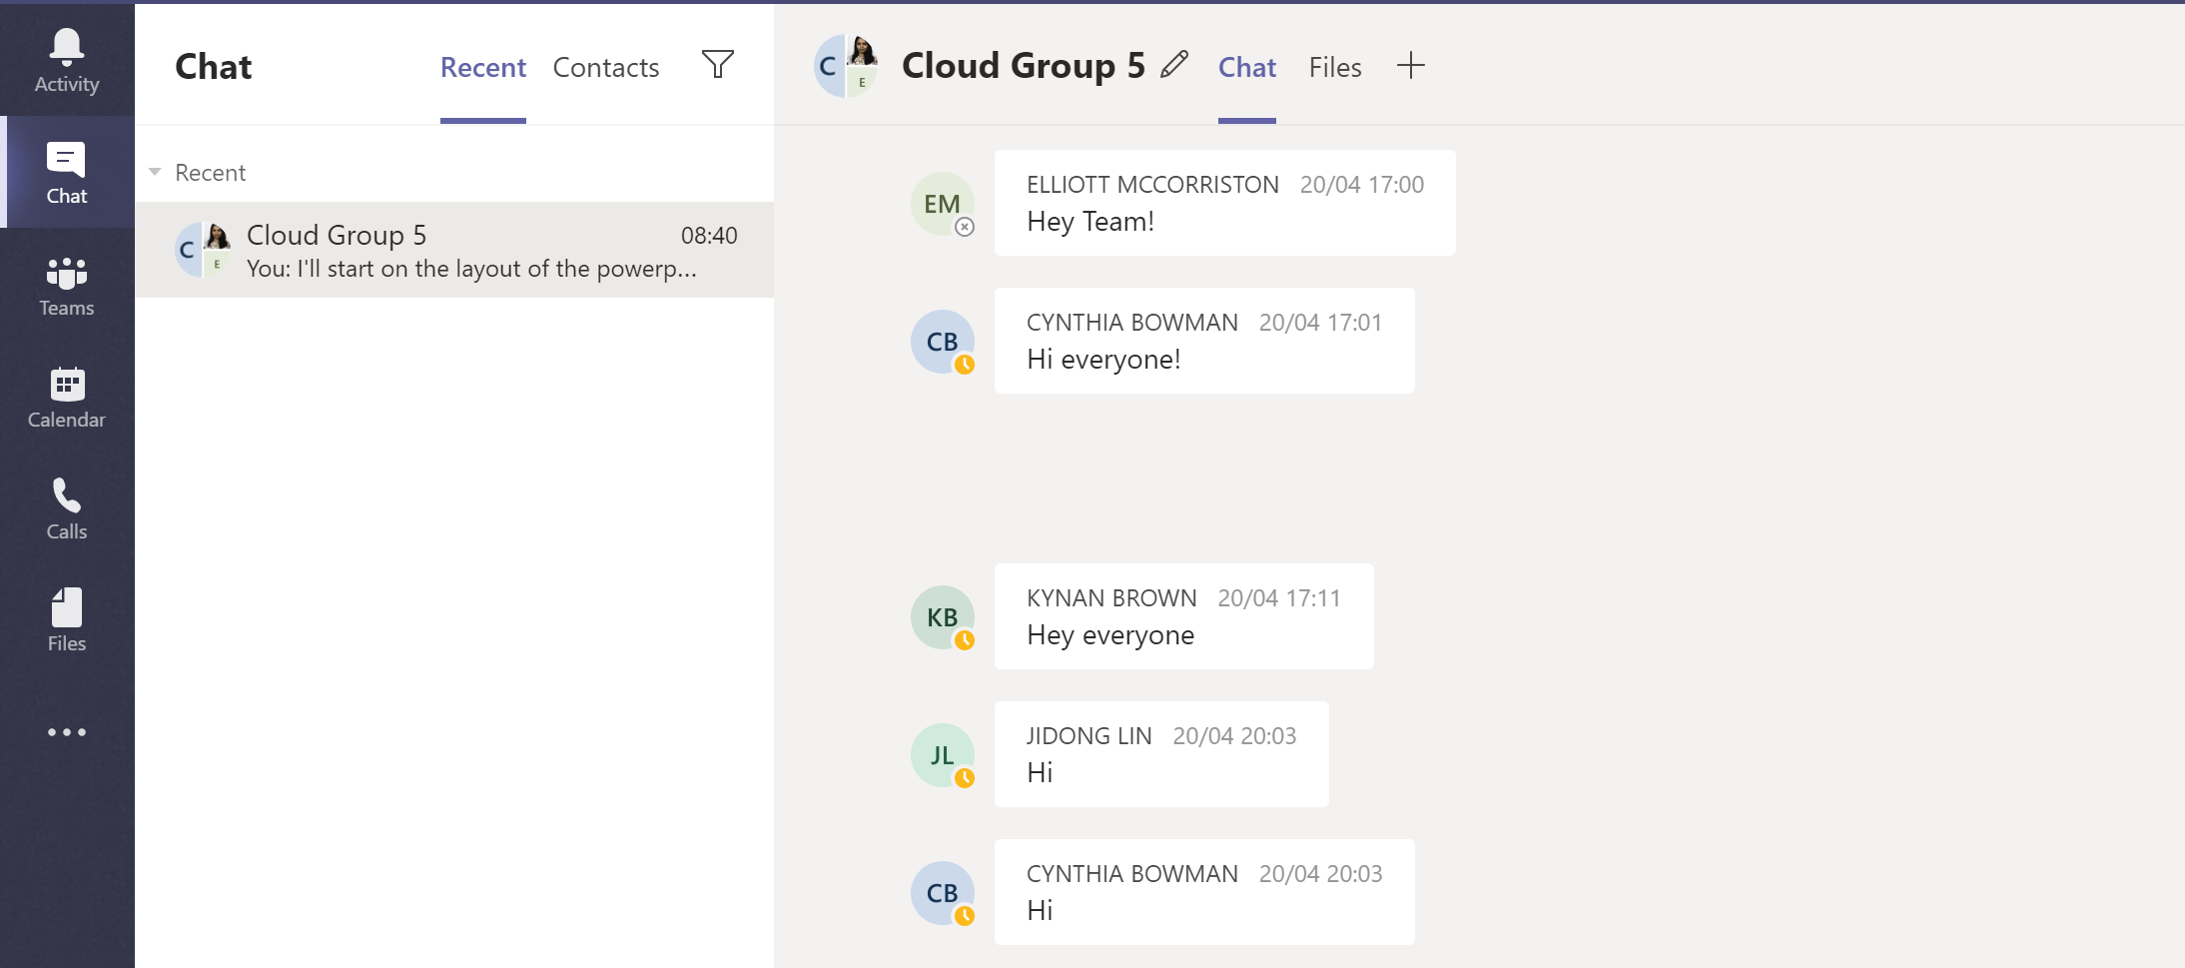
Project Setup
TRELLO
GOOGLE DOCS
GITHUB
MS TEAMS CHAT

Slide 4
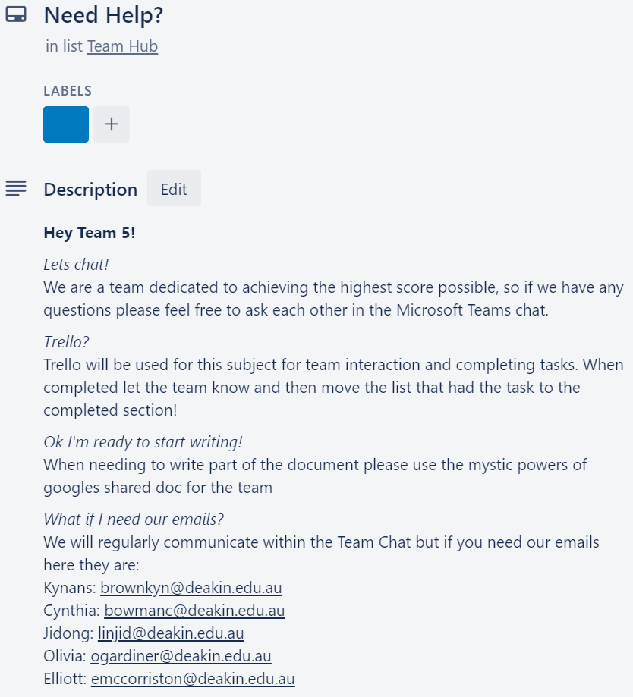
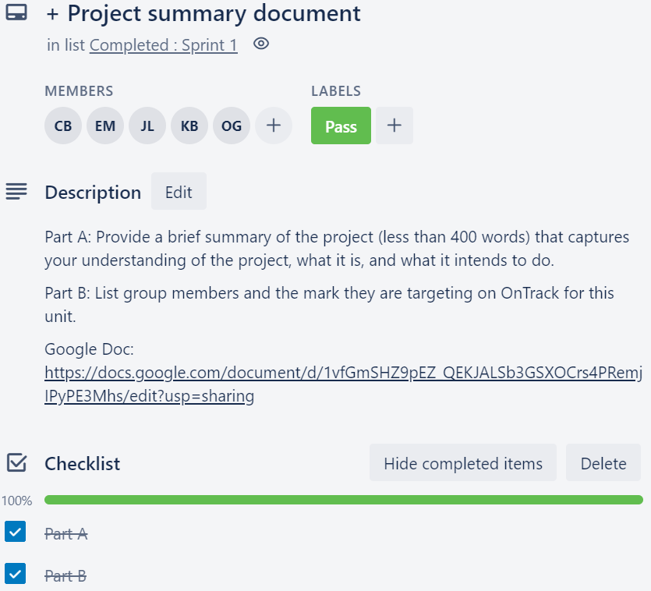
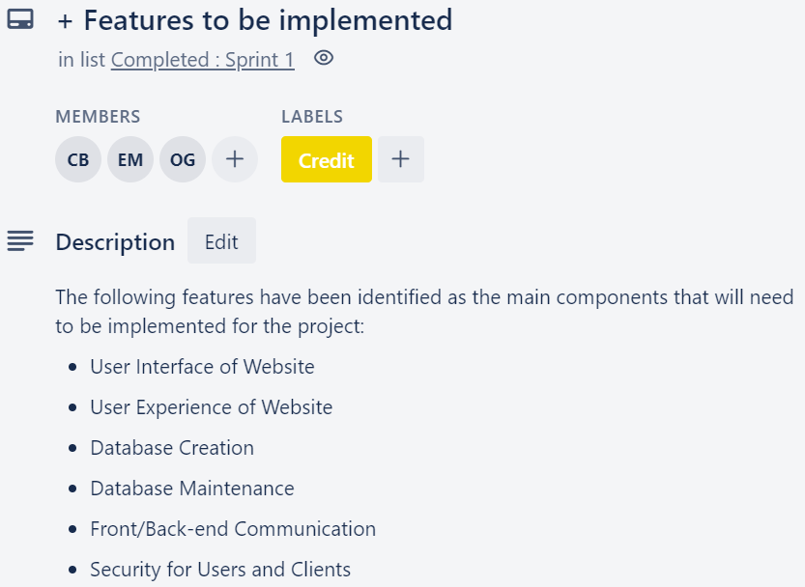
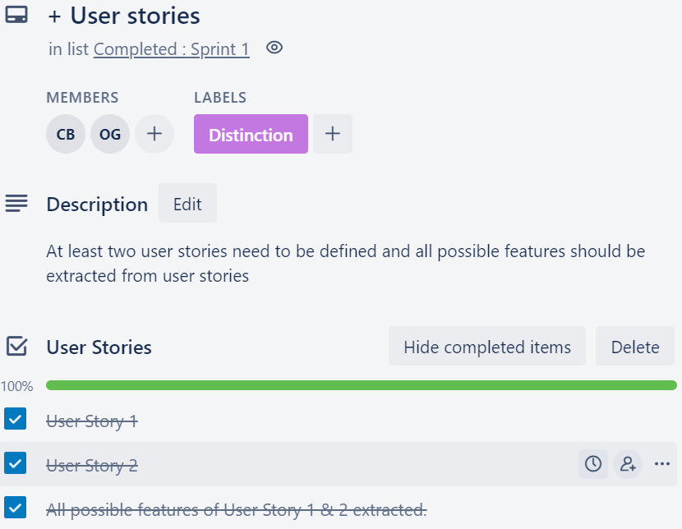
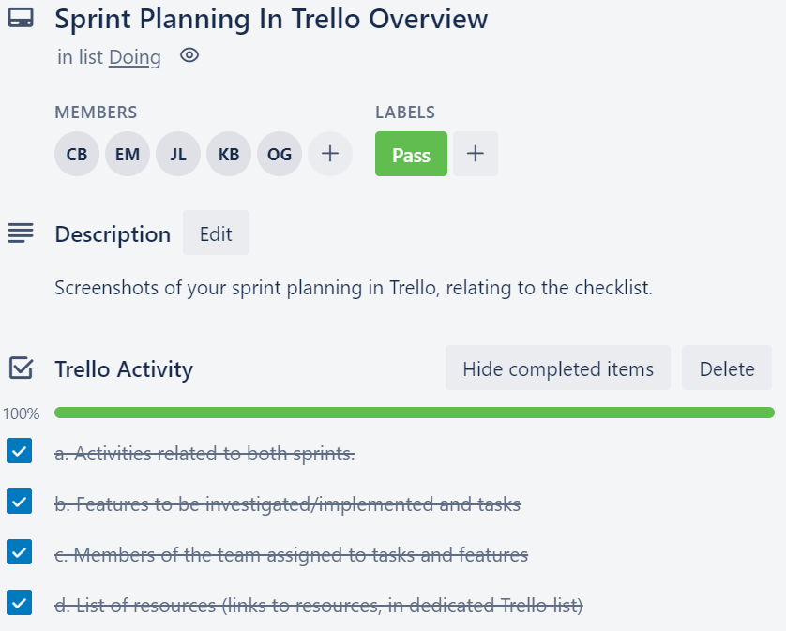
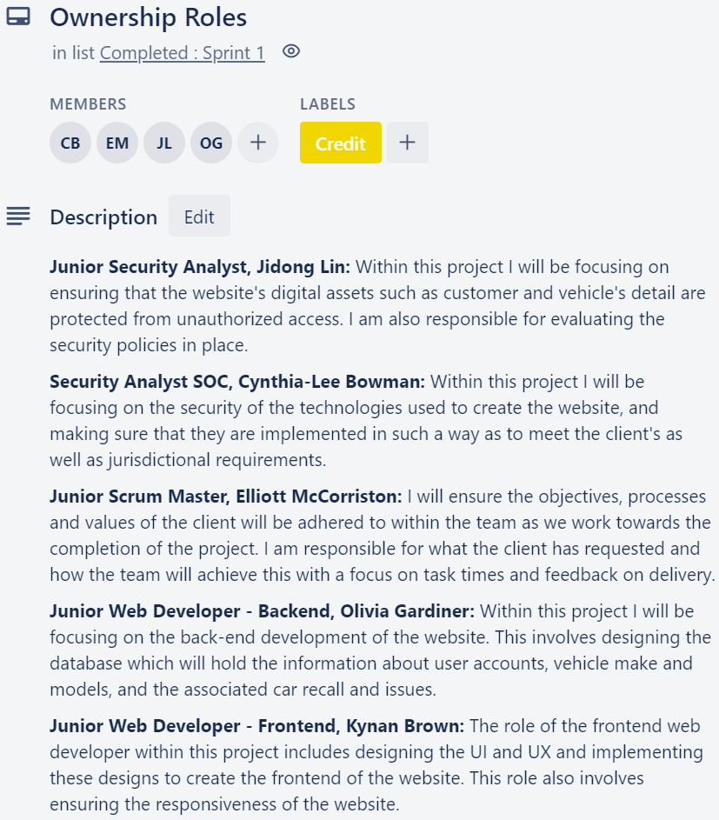
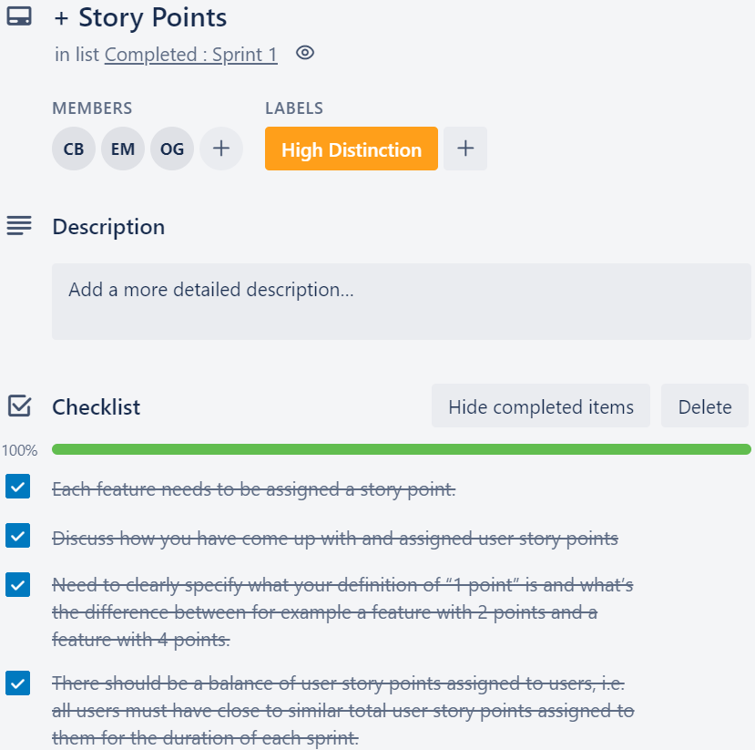
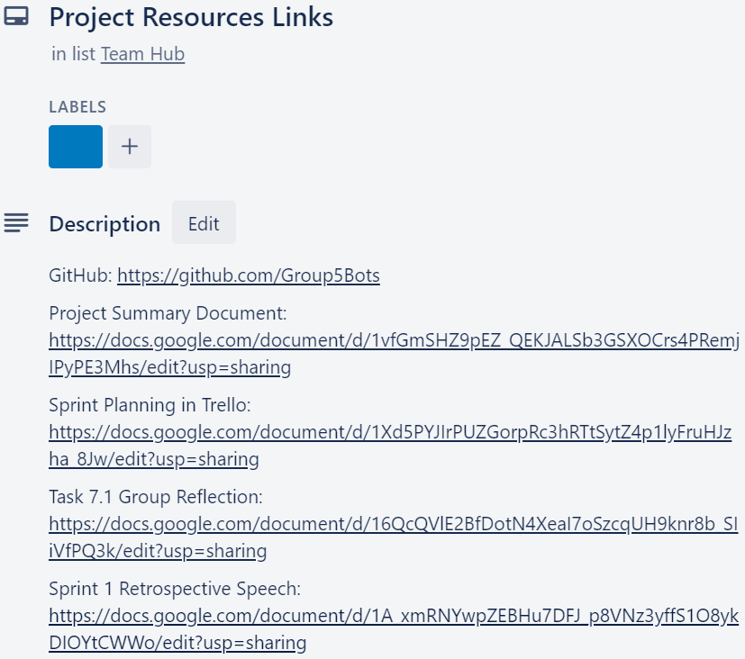
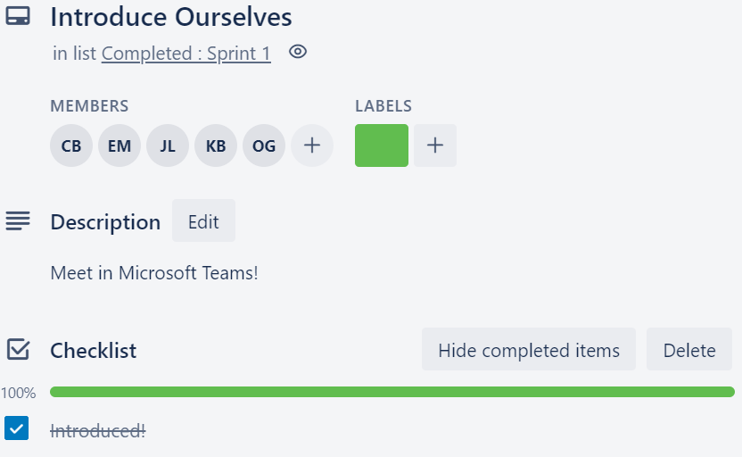
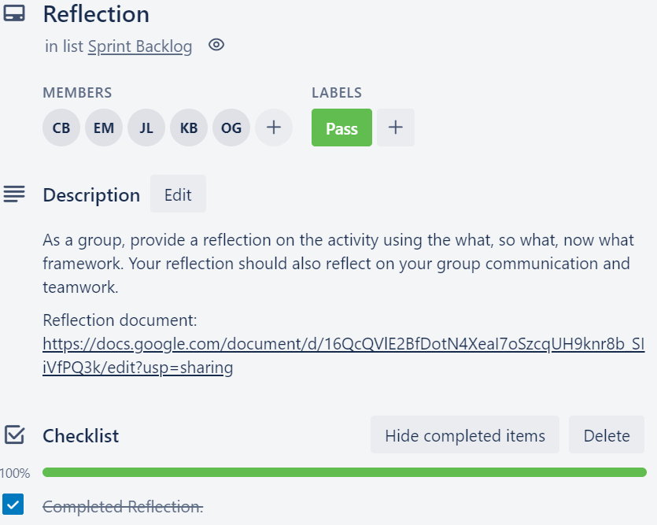
Trello Tasks
Sprint 1
LABEL KEYS:
GENERAL PASS CREDIT DISTINCTION HIGH DISTINCTION

Slide 5
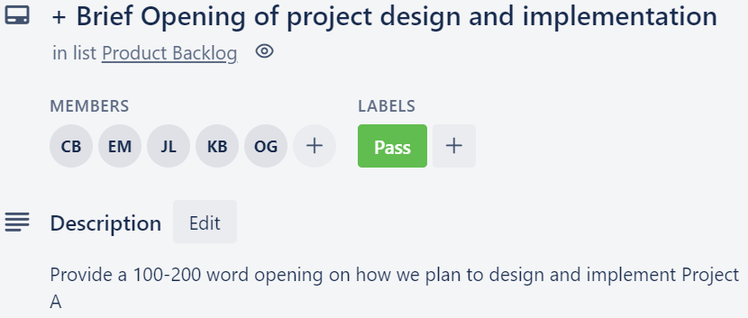
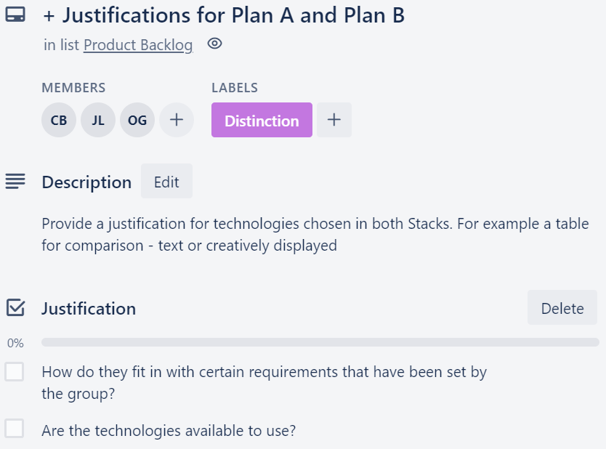
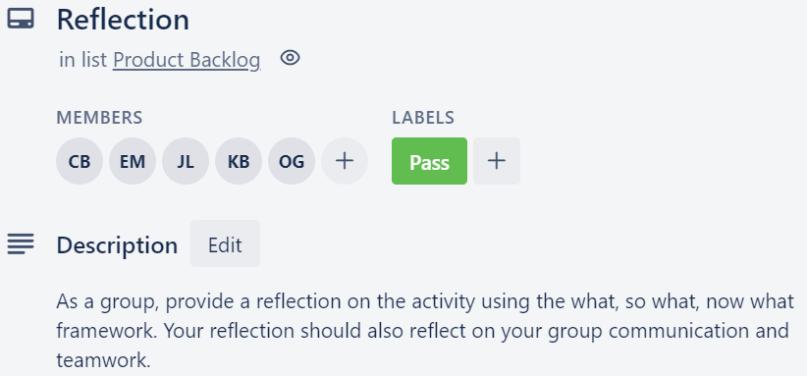
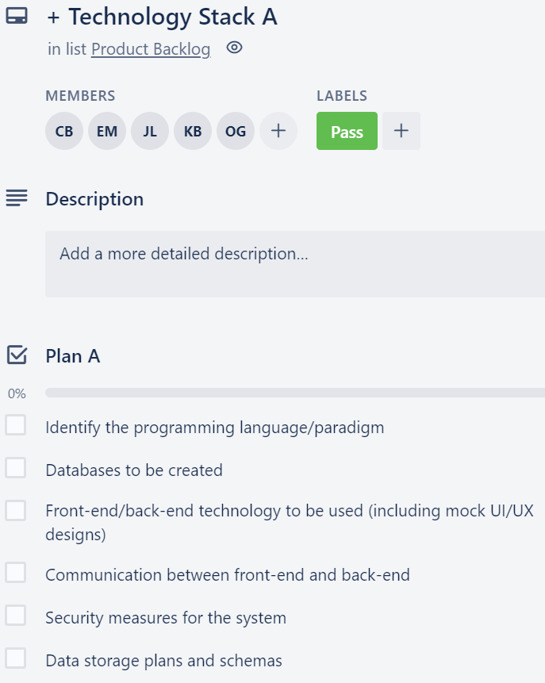
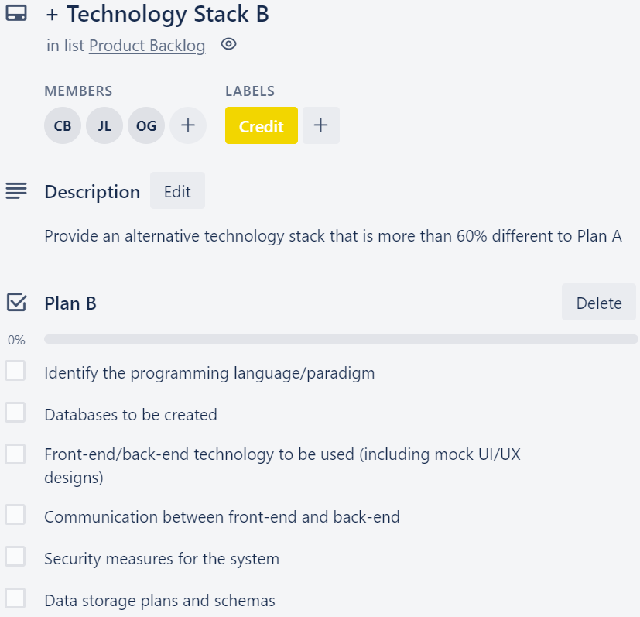
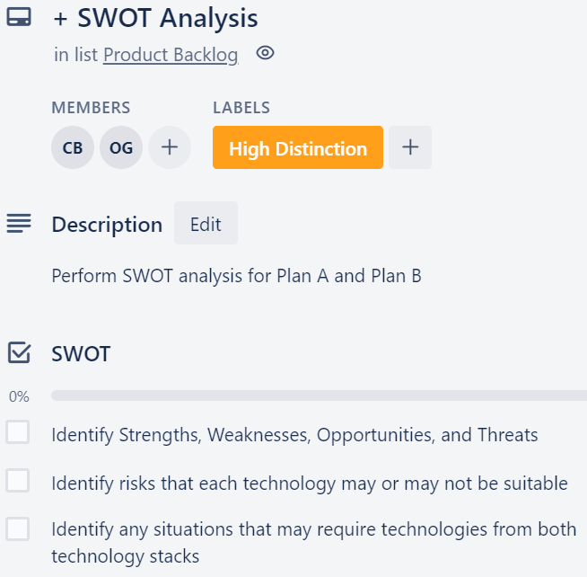
Trello Tasks
Sprint 2

Slide 6
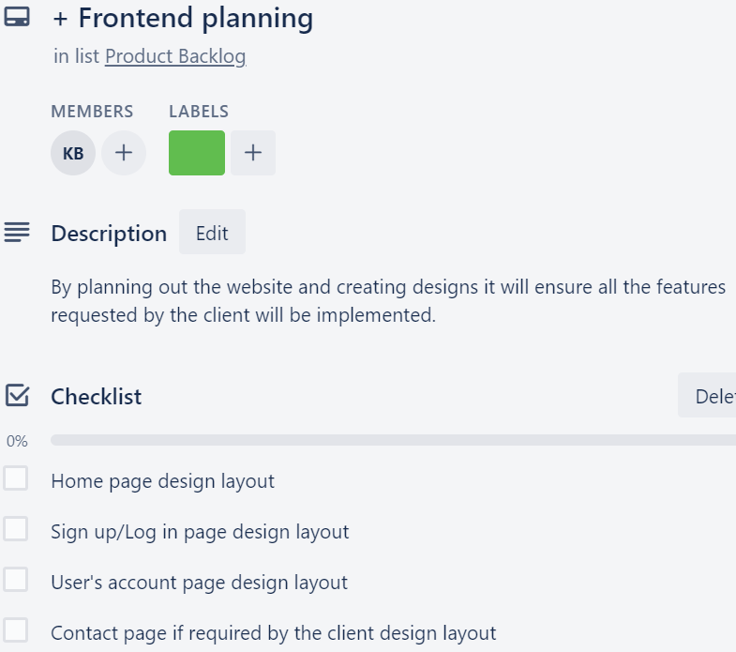
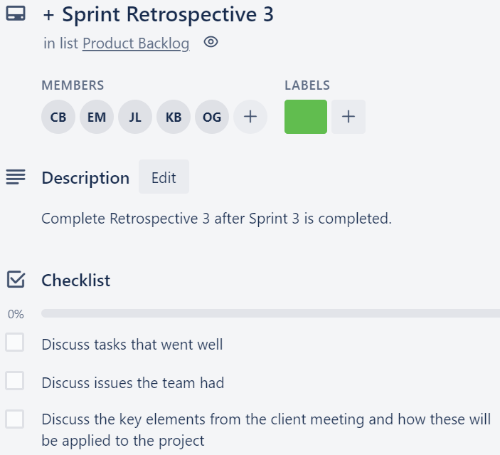
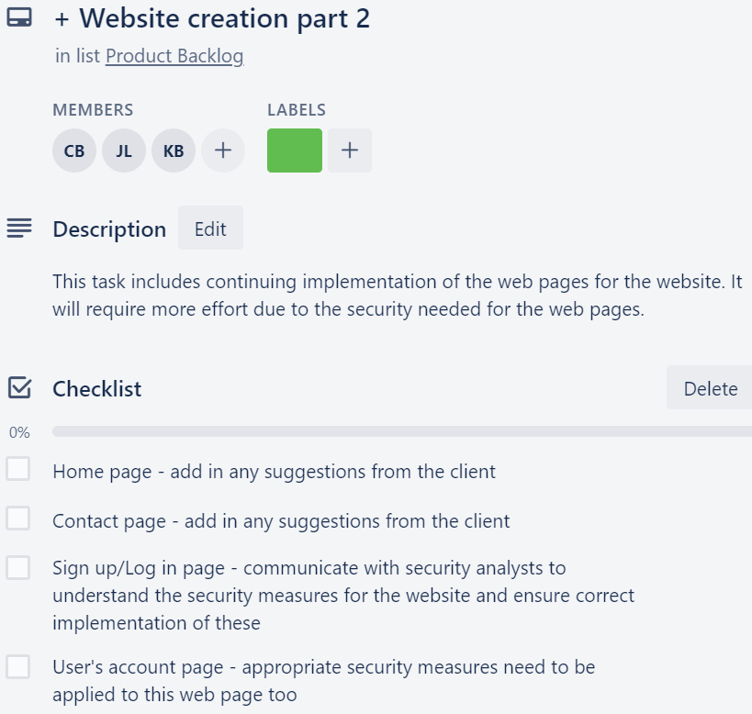
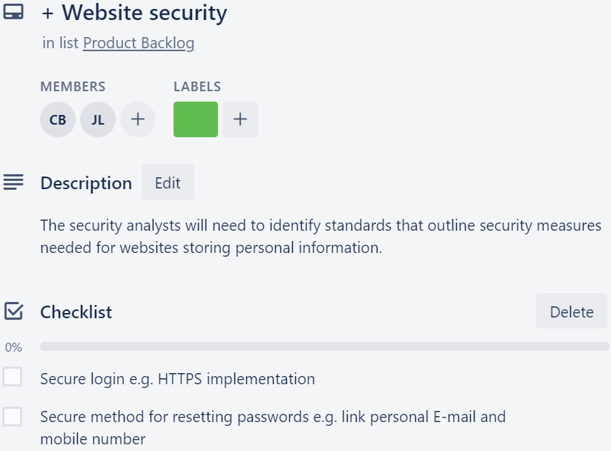
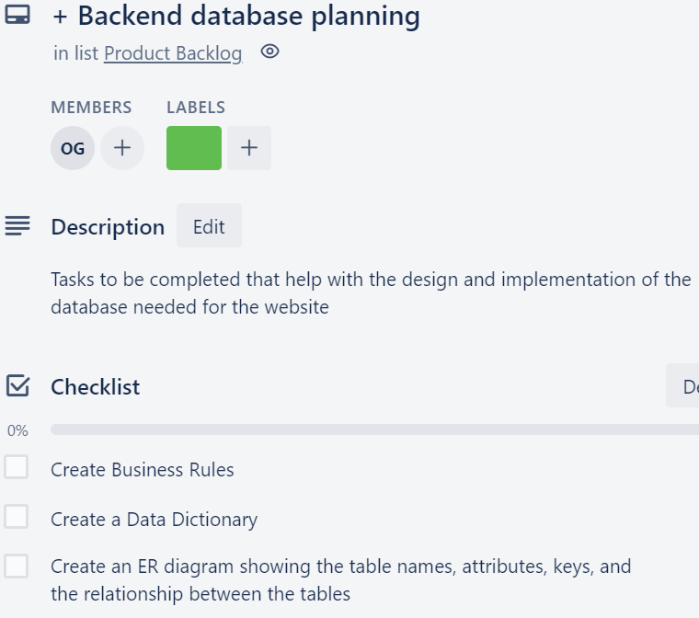
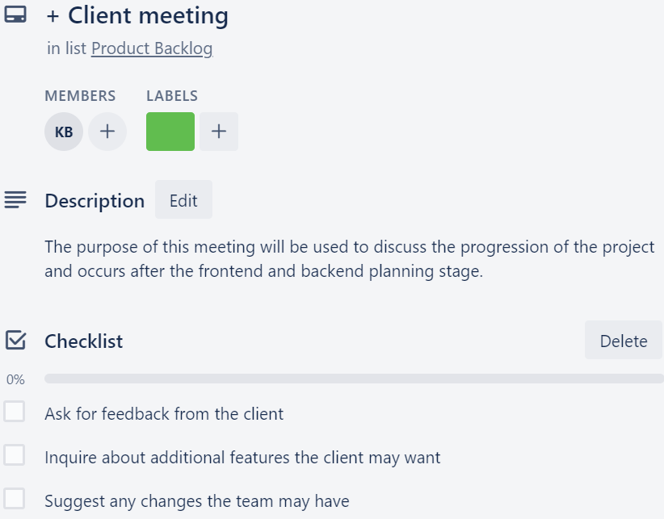
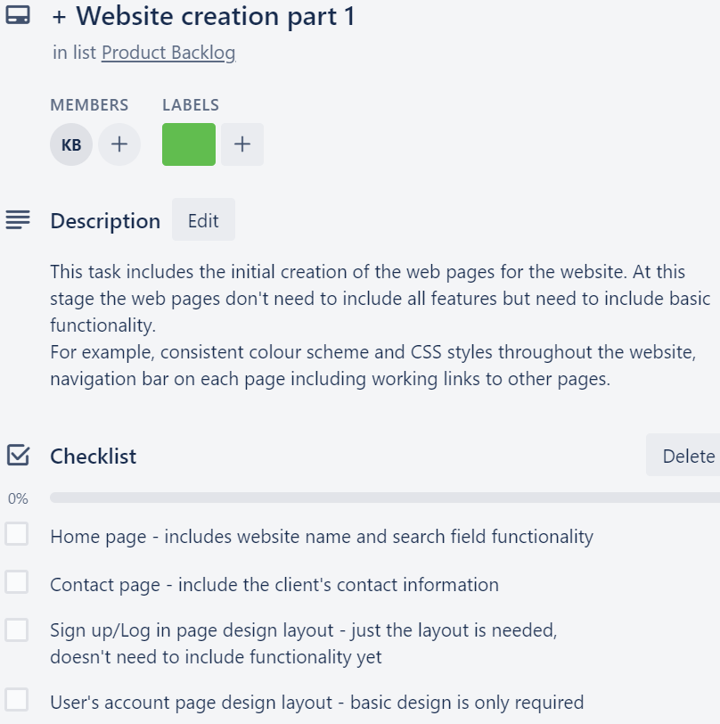
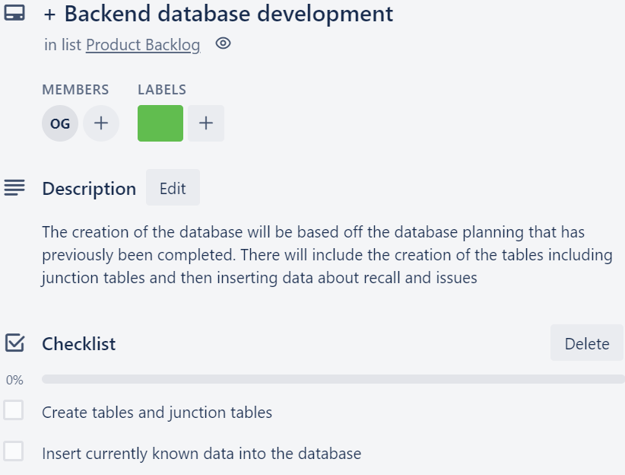
Trello Tasks
Sprint 3 - 4

Slide 7





Sprint Planning
Ownership Roles
JIDONG
LIN
Junior Security Analyst
CYNTHIA-LEE
BOWMAN
Security Analyst SOC
ELLIOTT
MCCORRISTON
Junior Scrum Master
OLIVIA GARDINER
Junior Web Developer (Backend)
KYNAN BROWN
Junior Web Developer (Frontend)

Slide 8
Sprint Planning
User Stories and Features
As a user I want to create an account so that I can register my car(s)
➲ Secure webpage for the user to create an account with a username and password
#1
➲ Secure webpage for the user to add the details of their car(s) to their account
As a user I want to fill in a web form (that searches the database) so that I can know if the make and model of my car has any issues or recall notices
➲ Webpage that displays the input fields for car make and models (including make, model, year, name)
#2
➲ Display any new recall or issues that match the user’s search query
As a user I want to have an account so that I can be informed (sent a notification) when a new recall or issue is added to the database that matches my car(s) make and model
#3
➲ Send a notification to users via their preferred contact method when their registered car(s) matches a new recall or issue

Slide 9
Sprint Planning
Story Points
➲ Secure webpage for the user to create an account with a username and password
3 points
Kynan • Jidong • Cynthia
#1
➲ Secure webpage for the user to add the details of their car(s) to their account
2 points
Olivia • Jidong
➲ Webpage that displays the input fields for car make and models (including make, model, year, name)
2 points
Kynan • Elliott
#2
➲ Display any new recall or issues that match the user’s search query
2 points
Kynan • Olivia
#3
➲ Send a notification to users via their preferred contact method when their registered car(s) matches a new recall or issue
4 points
Elliott • Olivia • Cynthia

Slide 10









Group Reflection / Retrospective
WHAT WORKED WELL?
WHAT DIDN’T WORK WELL?
ISSUES WE FACED
Setup of the project
Time management
Allocation of tasks
Team communication
Use of shared platforms
Working remotely
Tasks on Trello board
HOW TO FIX THE ISSUES?
Allocation of tasks to align with desired grade
Conduct sprint meetings earlier to improve time management
Edit the trello board to provide deadlines for tasks
Ensure all communication avenues are being utilised efficiently

